Slide 1

A Red Wine Quality Prediction Model
By: Harsh Bhardwaj (E23CSEU0427)
Supervisor: Dr. Susmita Das (Assistant Professor)
Date: 17th November, 2024
GitHub Repositor Link

Slide 2



To Predict The Quality Of Red Wine Based On Physico-Chemical Properties Using Machine Learning Techniques.
Dataset Contains Features Like Acidity, Residual Sugar, Chlorides, And Alcohol Content, Which Are Used As Predictors.
Approach: Pre-Process Data, Train Multiple Models, And Identify The Best Model.
Introduction

Slide 3
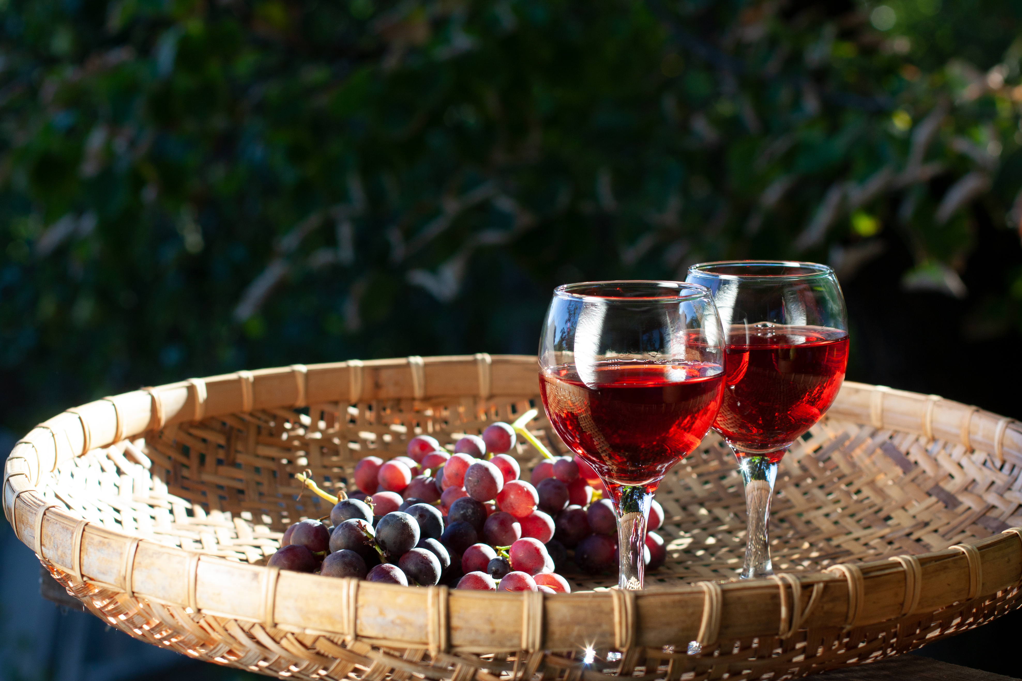
Background & Motivation
Wine Quality Prediction: A Crucial Task In The Wine Industry For Quality Control.
Motivation: Automate Quality Prediction For Efficiency, Reduced Costs, And Consistency.
Challenges: Requires Understanding The Complex Relationship Between Chemical Properties And Taste.

Slide 4
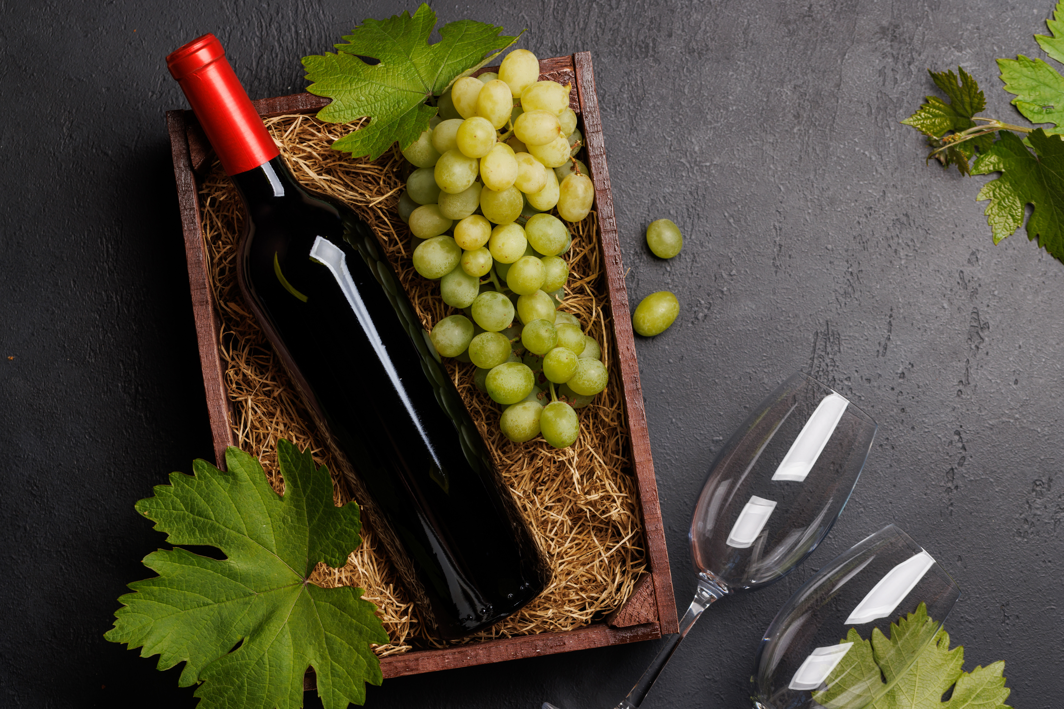
Machine Learning In Food And Beverage: Brief Overview Of ML Models Used For Product Quality Prediction.
Comparison: Logistic Regression, SVM, And Random Forest Applied In Previous Studies On Wine Quality.
Related
Work

Slide 5


Methodology
Data Collection: Red Wine Quality Dataset With 11 Features And A Quality Score.
Preprocessing: Handled Class Imbalance With SMOTE, Applied Feature Scaling.
Model Selection: Built Pipelines For Logistic Regression, SVM, And Random Forest.
Tuning: Used Grid Search For Hyper-Parameter Tuning On SVM And Random Forest Models.

Slide 6





System Requirements
Hardware
Software
Python Libraries
Basic Computing Device (Laptop/Desktop).
Flask For Web App Development
Jupyter Notebook For Model Development
Python Libraries: Pandas, NumPy, SKLearn, JobLib, SeaBorn

Slide 7


Experimental Results
Model Evaluation: Display Cross-Validation Scores, Accuracy, And Classification Report.
Best Model: Support Vector Classifier (SVC) Achieved The Highest Accuracy.
Confusion Matrix: Visual Representation Of Classification Performance.

Slide 8
Random Forest Feature Importances: Chart Showing The Most Influential Features In The Dataset (e.g., Alcohol, pH).
Insights: Brief Explanation Of How Each Feature Impacts Wine Quality.
Feature Importance

Slide 9
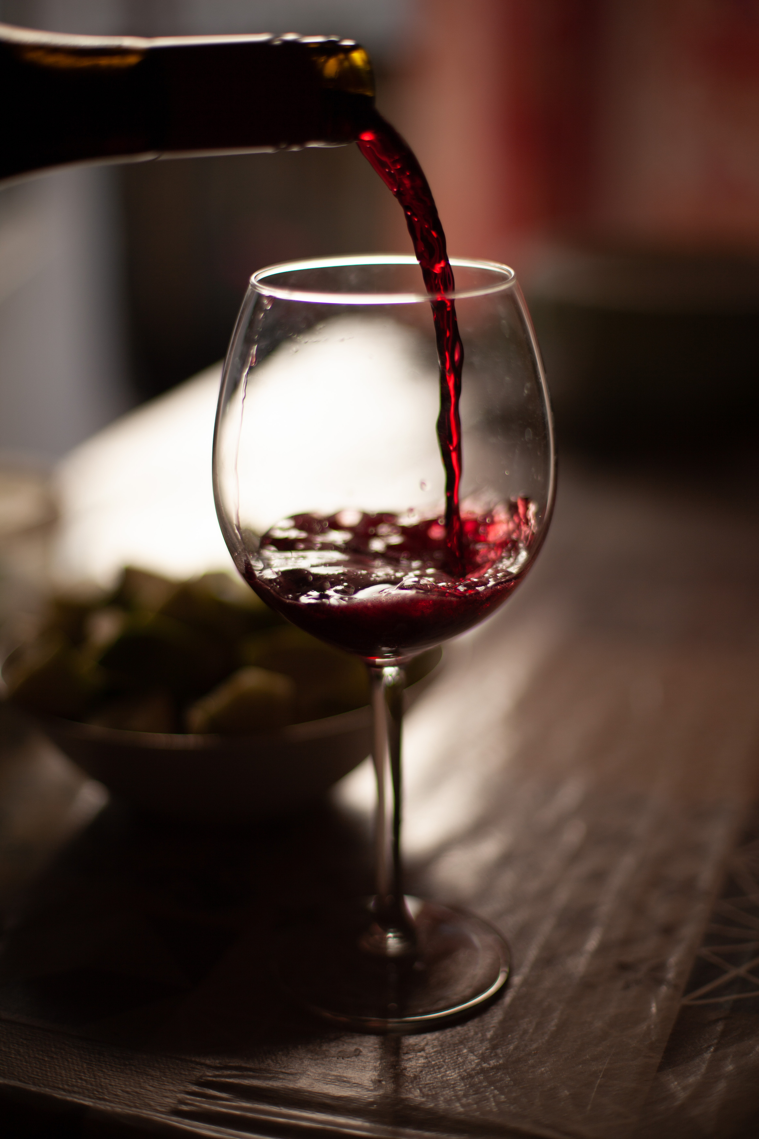
Overview: Web Interface To Input Wine Characteristics And Predict Quality.
Features:
User-Friendly Form To Enter Wine Properties.
Dark/Light Mode Toggle.
Back-End Model Integration With Real-Time Predictions.
Flask
Application

Slide 10
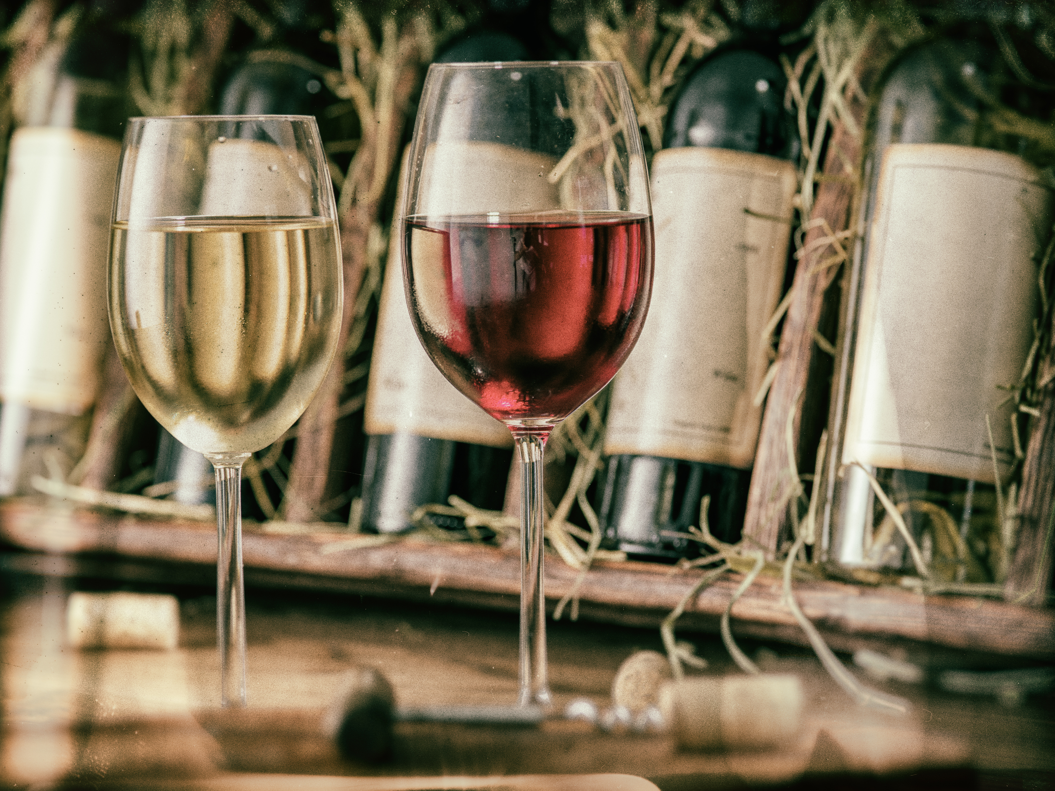
Conclusion
Key Findings: Model Predicts Quality With Acceptable Accuracy, SVC Performs Best.
Limitations: Dataset Limited To Red Wine; Results May Vary With Different Datasets Or Feature Engineering.

Slide 11
Future Work
Expand To White Wine
Enhance Model
Deploy To Cloud
Extend The Model To Work On Other Types Of Wine.
Try Ensemble Learning Or Neural Networks For Potentially Higher Accuracy.
Host The Application For Broader Accessibility.

Slide 12

Thank You!
GitHub Repository

